Slide 1




Central Limit Theorem and Mean, Median, Mode Real Life Use-case
~ CSAI-B2-GRP_3

Slide 2



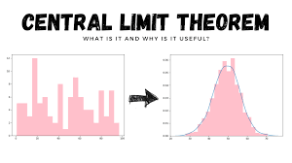
Key Concepts Overview
The Central Limit Theorem (CLT) is a fundamental statistical principle that describes how sample means behave across different populations. It provides powerful insights into statistical inference and data analysis.

Slide 3

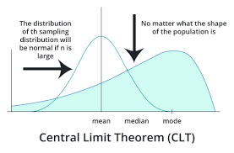


What is the Central Limit Theorem?
Definition:
The CLT states that when independent random variables are added, their properly normalized sum tends toward a normal distribution, even if the original variables are not normally distributed.
Core Principles:
As sample size increases, the distribution of sample means approaches a normal distribution
Works regardless of the underlying population distribution
Applies when sample size is sufficiently large (typically n ≥ 30)

Slide 4


Key Applications of Mean, Median, Mode
The average of a dataset, calculated by summing all values and dividing by the number of values.
The middle value in a sorted dataset, which separates into halves
The value that appears most frequently in a dataset.

Slide 5
Mean (Average)
Best Used For:
Normally distributed data with no extreme outliers
Continuous numerical data
Symmetric data sets
Calculating central tendency in:
Financial analysis (average stock prices)
Performance metrics (average test scores)
Scientific measurements with consistent scale
When all data points are equally important

Slide 6
Median
Best Used For:
Data sets with significant outliers
Skewed distributions
Income and salary data analysis
Real estate pricing
Healthcare statistics
Data with extreme values that might distort
the mean
When you want a more robust central measure that isn't influenced by extreme values

Slide 7
Mode
Best Used For:
Categorical data
Frequency analysis
Identifying most common:
Customer preferences
Survey responses
Categorical variables
Repeated occurrences in a data set
Qualitative data analysis
Marketing research to understand most
frequent trends

Slide 8

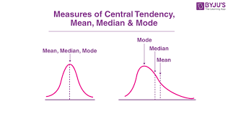
Presenting Results
Comparative Analysis Scenario
Statistics | Best Used When | Limitation
Mean | Symmetric data | Sensitive to outliers
Median | Skewed distributions | Loses detailed information
Mode | Categorical data | May not exist in continuous data

Slide 9

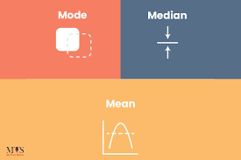
Real-Life Case Studies
Colab Link

Slide 10
Real Life Case Studies: Median
1. Real Estate Market Research
Project: Housing price analysis
Example: Determining median home price in a city
Advantage: Less affected by extremely expensive or cheap properties
Insight: Provides more representative central value in housing markets

Slide 11
Real Life Case Studies: Median
2. Salary Compensation Studies
Project: Understanding income distribution
Example: Tech companies analyzing employee compensation
Benefit: Reveals true central income without being skewed by executive salaries
Application: Compensation benchmarking and fairness assessment

Slide 12
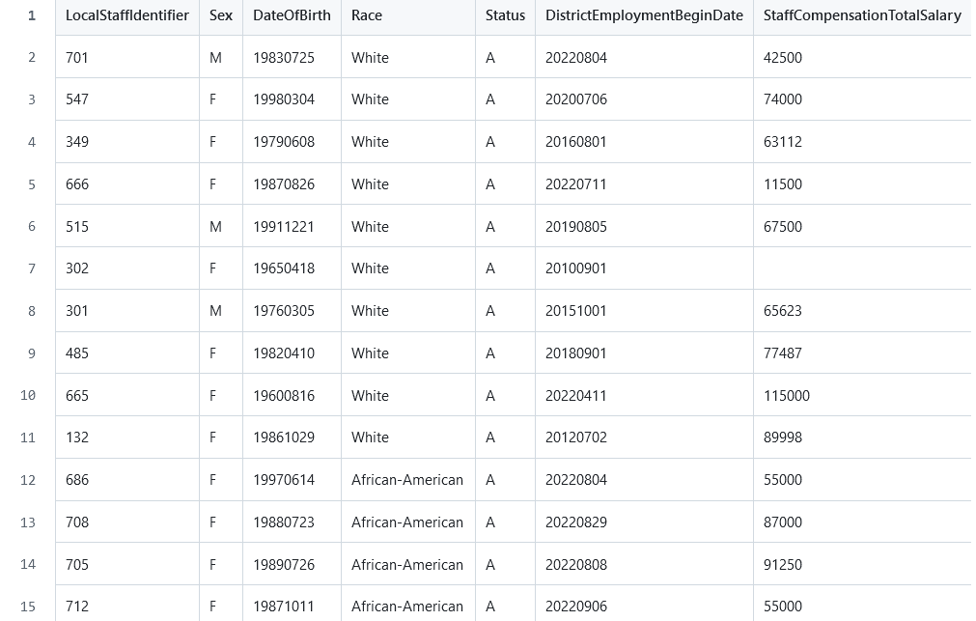
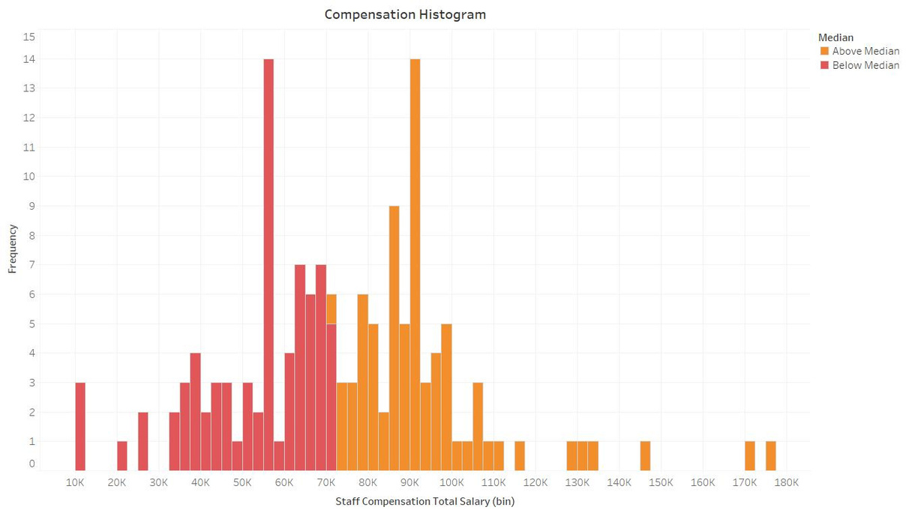
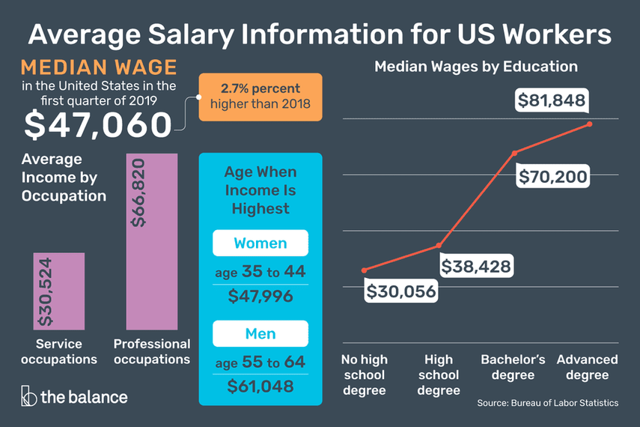
Real Life Case Studies: Median

Slide 13
Real Life Case Studies: Mean
1. E-commerce Performance Analysis
Project: Analyzing average customer spending
Example: Amazon tracks average purchase value per customer
Calculation: Sum of all transaction values / Total number of transactions
Insights: Helps in pricing strategy, customer segmentation

Slide 14
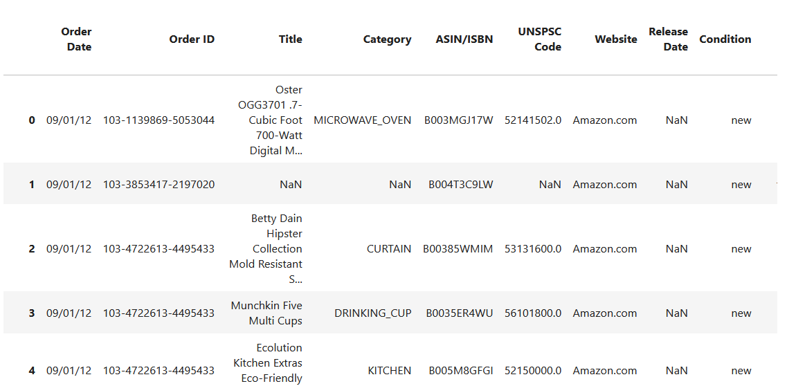
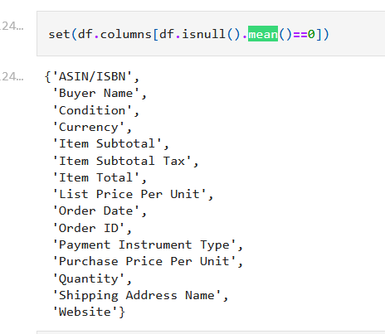
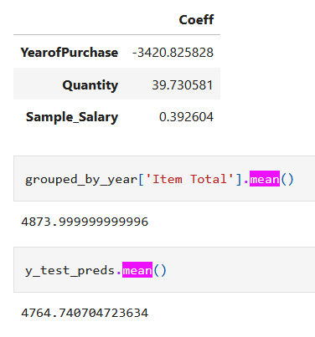
Real Life Case Studies: Mean

Slide 15

Real Life Case Studies: Mean
2. Manufacturing Quality Control
Project: Monitoring product dimensions in precision engineering
Example: Measuring average diameter of machine-produced components
Application: Ensuring consistent product specifications
Benefit: Quickly identifies manufacturing process variations

Slide 16
Real Life Case Studies: Mode
1. Customer Behavior Analysis
Project: Retail product preference tracking
Example: Identifying most frequently purchased product category
Application:
Inventory management
Marketing campaign targeting
Store layout optimization

Slide 17



Real Life Case Studies: Mode
2. Healthcare Epidemiology
Project: Disease symptom frequency
Example: Tracking most common symptoms in patient records
Benefit:
Rapid identification of prevalent health conditions
Designing targeted medical interventions

Slide 18
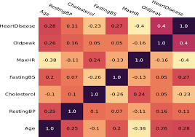

Real Life Case Studies: Mode

Slide 19
Summarizing Results
Mean is best when the data is symmetrical and doesn’t have extreme values. It represents the overall average.
Median is more robust to outliers and is better for skewed distributions, where extreme values might distort the mean.
Mode gives insight into the most frequent values and is useful for categorical data or understanding product preferences.

Slide 20
Kurtosis
Kurtosis measures the tailedness of a distribution—how heavy or light the tails are compared to a normal distribution. It indicates the presence of outliers and whether the data points are concentrated around the mean or spread out.
least
greatest

Slide 21


Types of Kurtosis:
Mesokurtic (Kurtosis = 3):
The dataset has a kurtosis similar to a normal distribution.
Moderate tails and no extreme outliers.
Example: Normal distribution.
Leptokurtic (Kurtosis > 3):
The distribution has heavier tails and a sharper peak.
Indicates more extreme outliers.
Example: Data with frequent extreme deviations.
Platykurtic (Kurtosis < 3):
The distribution has lighter tails and a flatter peak.
Indicates fewer extreme outliers.
Example: Uniform distribution.

Slide 22
Skewness
Skewness measures the asymmetry of a data distribution around its mean.
Types:
Positive Skew: Long tail on the right; mean > median > mode.
Negative Skew: Long tail on the left; mean < median < mode.
Zero Skew: Symmetrical; mean = median = mode (normal distribution).
least
greatest
Median

Slide 23
Uses of Skewness
Why It Matters:
Identifies asymmetry in data, guiding analysis and decision-making.
Applications:
Finance: Risk-return analysis.
Medicine: Patient data trends.
Marketing: Customer behavior insights.
Importance:
Selects appropriate statistical tests.
Shapes machine learning model designs.
Supports data normalization strategies.

Slide 24
MEAN OVER MEDIAN/MODE
1. Linear Regression (or other regression models)
Use of Mean: In linear regression, the goal is to minimize the residual sum of squares, and the mean of the target variable (y) is often used as a reference or starting point. If you’re looking at the distribution of features or targets, the mean is typically used in calculating the loss function (like MSE – Mean Squared Error).
Why not Median/Mode: The median and mode are more robust to outliers but less useful in minimizing the continuous error in regression, where every data point's deviation from the mean matters.

Slide 25
MEAN OVER MEDIAN/MODE
2. Feature Scaling (Normalization)
Use of Mean: When normalizing or standardizing features, the mean of each feature is subtracted, and then the result is divided by the standard deviation (Z-score normalization). This helps to center the data and bring it into a comparable range for machine learning algorithms.
Why not Median/Mode: The median can also be used in certain robust scaling methods, but mean is more appropriate when you assume the data is normally distributed. Mode isn't generally used in scaling as it represents the most frequent value, which doesn’t help in capturing the spread of the data.

Slide 26
MEAN OVER MEDIAN/MODE
3. Outlier Detection in Gaussian-distributed Data
Use of Mean: In cases where you assume that your data is approximately Gaussian (normally distributed), the mean is very important in identifying and handling outliers. If the data follows a normal distribution, values that lie far away from the mean (in terms of standard deviations) can be considered outliers.
Why not Median/Mode: The median is more robust and less affected by outliers, but when data is normally distributed, the mean and standard deviation provide more meaningful insights for detecting anomalies.

Slide 27
MEAN OVER MEDIAN/MODE
4. Imputing Missing Values
Use of Mean: For numerical features with missing values, you can impute missing values with the mean when the data is approximately symmetric and lacks extreme outliers. This approach assumes that the missing data is missing at random and can be reasonably estimated by the central tendency.
Why not Median/Mode: The median is more suitable if the data has outliers or skewed distributions. The mode is used for categorical data, but in numerical contexts, the mean is preferred if the data is balanced and without heavy skew.

Slide 28
MEAN OVER MEDIAN/MODE
5. Optimization Algorithms (e.g., Gradient Descent)
Use of Mean: Algorithms like gradient descent for optimization in machine learning often involve calculating the average (mean) of gradients or error terms to update model parameters. The mean is the central point that these algorithms attempt to converge toward.
Why not Median/Mode: The mean provides a smooth, continuous path to optimization, and its use ensures that the algorithm converges faster and more effectively, especially in cases where the data distribution is not heavily skewed.

Slide 29
MEAN OVER MEDIAN/MODE
6. K-Means Clustering
Use of Mean: In the K-means clustering algorithm, the mean is used to calculate the centroid of a cluster. Each cluster's centroid is the arithmetic mean of all the points assigned to that cluster.
Why not Median/Mode: The median or mode is not typically used in K-means because it would not reflect the true center of the data points in a cluster as effectively as the mean, especially in a continuous feature space.

Slide 30
MEAN OVER MEDIAN/MODE
7. Principal Component Analysis (PCA)
Use of Mean: PCA works by finding the directions (principal components) that maximize variance in the data. Before performing PCA, it’s common to subtract the mean of each feature to center the data. This ensures that the first principal component reflects the direction of maximum variance.
Why not Median/Mode: The mean helps ensure that the components capture the spread of the data around the center. The median could be used in certain outlier-sensitive PCA variants, but in standard PCA, the mean is more commonly used.

Slide 31
MEAN OVER MEDIAN/MODE
8. Time Series Analysis
Use of Mean: In certain time series forecasting models (such as ARIMA or simple moving averages), the mean is used to detect trends or to smooth the time series data. This is particularly true if the data shows seasonality or is symmetric in nature.
Why not Median/Mode: Median smoothing might be used in cases where the data has extreme outliers, but for most time series models, the mean offers a better overall trend estimate.

Slide 32
Median over Mean/Mode
1. Robust Regression (e.g., Quantile Regression)
Use of Median: In regression models like quantile regression, the median is used to predict the 50th percentile of the target variable. It is more robust than the mean when dealing with outliers or skewed data.
Why not Mean: The mean is sensitive to outliers, while the median focuses on the central tendency, making it more reliable in the presence of extreme values.

Slide 33
Median over Mean/Mode
2. Outlier Detection and Removal
Use of Median: In datasets with outliers or skewed distributions, the median is more useful for detecting the center of the data and identifying anomalies without being affected by extreme values.
Why not Mean: The mean can be pulled in the direction of outliers, leading to misleading results. The median is more resistant to outliers and provides a more stable measure.

Slide 34
Median over Mean/Mode
3. Imputing Missing Values
Use of Median: When imputing missing values in numerical data, the median is often preferred when the data is skewed or contains outliers. This ensures that the imputed values reflect the central tendency without being distorted by extreme values.
Why not Mean: The mean can be heavily affected by outliers or skewed distributions, making it less reliable for imputation in such cases.

Slide 35
Median over Mean/Mode
4. Handling Skewed Data Distributions
Use of Median: For data that is not symmetrically distributed (e.g., highly skewed data), the median provides a better representation of the central value. This is important when the data contains long tails or is not normally distributed.
Why not Mean: The mean can be distorted by skewed distributions, as it is sensitive to the size of extreme values. The median is much more robust in these scenarios.

Slide 36
Median over Mean/Mode
5. Non-Normal Data (Heavy Tailed Distributions)
Use of Median: When working with heavy-tailed or non-normal distributions (such as financial data, income data, etc.), the median is a better indicator of central tendency because it is less sensitive to extreme values.
Why not Mean: The mean may not accurately represent the central value in such cases because it is affected by large outliers or extreme data points.

Slide 37
Median over Mean/Mode
6. K-Nearest Neighbors (K-NN) for Regression
Use of Median: In K-NN regression, the median can be used as an alternative to the mean to predict the target value by taking the median of the K nearest neighbors' outputs. This can help mitigate the influence of outliers.
Why not Mean: The mean can be skewed by outliers among the nearest neighbors, while the median provides a more robust estimate.

Slide 38
Median over Mean/Mode
7. Feature Engineering (e.g., Robust Scaling)
Use of Median: In robust scaling, features are scaled using the median and interquartile range (IQR) instead of the mean and standard deviation. This approach is useful for data with outliers, as it focuses on the central 50% of the data.
Why not Mean: The mean and standard deviation are sensitive to outliers, which can distort the scaling, whereas using the median avoids this problem.

Slide 39
Median over Mean/Mode
8. Time Series Analysis with Seasonal Data
Use of Median: For time series data that is heavily skewed or has seasonal effects, the median can be used to smooth the data. This helps capture the central trend while ignoring short-term fluctuations caused by outliers.
Why not Mean: The mean might be heavily influenced by outliers or seasonal spikes, whereas the median offers a more reliable measure in these contexts.

Slide 40
Mode over Mean/Median
1. Categorical Data Imputation
Use of Mode: When imputing missing values in categorical features (e.g., gender, color, product type), the mode (the most frequent value) is used to fill in missing entries. This ensures that the imputed value reflects the most common category in the data.
Why not Median/Mean: The mean and median are not applicable to categorical data. The mode is the only meaningful measure of central tendency for non-numeric data.

Slide 41


Mode over Mean/Median
2. Classification Models with Categorical Features
Use of Mode: In classification tasks, when dealing with categorical features, the mode can be used to encode categories. For instance, in algorithms like decision trees, the mode of a target class can be used to assign labels to missing data points based on the most frequent class.
Why not Median/Mean: The mean and median are not meaningful for categorical data, as they apply only to numerical data. The mode is used to identify the most frequent category, which is useful in predicting or assigning class labels.

Slide 42
Mode over Mean/Median
3. Text Classification and Natural Language Processing (NLP)
Use of Mode: In text-based models (e.g., topic modeling or document classification), the mode can be used to identify the most frequent terms or keywords in a document or corpus. This helps in feature extraction, where the most common words or phrases are used to categorize text.
Why not Median/Mean: The mean and median are not useful in text data. The mode gives insights into the most frequent occurrences of words, making it essential for tasks like bag-of-words or TF-IDF models.

Slide 43
Mode over Mean/Median
4. Market Basket Analysis
Use of Mode: In market basket analysis (e.g., association rule mining), the mode is used to identify the most frequently purchased items or item combinations. This helps in understanding customer purchasing patterns and creating product recommendations.
Why not Median/Mean: The mean and median aren’t applicable to categorical data like item purchases. The mode helps find the most common items bought together, which is key in market basket analysis.

Slide 44
Mode over Mean/Median
5. Recommendation Systems (Collaborative Filtering)
Use of Mode: In collaborative filtering for recommendation systems, the mode can be used to identify the most frequently rated items or products by users. This information can help in recommending popular items to new users or to those with similar preferences.
Why not Median/Mean: The mean and median are less relevant in this context, as they do not directly capture the frequency of user preferences. The mode identifies the most popular items, which are often recommended.

Slide 45
Mode over Mean/Median
6. Anomaly Detection in Categorical Data
Use of Mode: For anomaly detection in categorical data, the mode can be used as the baseline to detect anomalies. Any data points that deviate significantly from the most frequent category might be flagged as anomalies.
Why not Median/Mean: The mean and median don’t apply to categorical data, making mode the only relevant measure to detect outliers or unusual categories.

Slide 46
Mode over Mean/Median
7. Customer Segmentation
Use of Mode: In customer segmentation, the mode can help identify the most frequent demographic categories (e.g., age group, purchasing frequency, or region) within each segment, providing insights into common customer profiles.
Why not Median/Mean: The median and mean are more useful for numerical features, while mode is specifically suited for identifying dominant or common categories in categorical features.

Slide 47
Mode over Mean/Median
8. Voting Systems
Use of Mode: In a voting system or ensemble models, the mode can be used to select the most common prediction from multiple models (e.g., in a majority voting classifier). This helps to consolidate the most frequent class prediction across models.
Why not Median/Mean: The mean and median are not applicable in this voting context since the output is categorical. The mode (majority vote) is the most logical method to choose the winning prediction.

Slide 48
Summarizing Results
Mean is best when the data is symmetrical and doesn’t have extreme values. It represents the overall average.
Median is more robust to outliers and is better for skewed distributions, where extreme values might distort the mean.
Mode gives insight into the most frequent values and is useful for categorical data or understanding product preferences.

